Slide 1
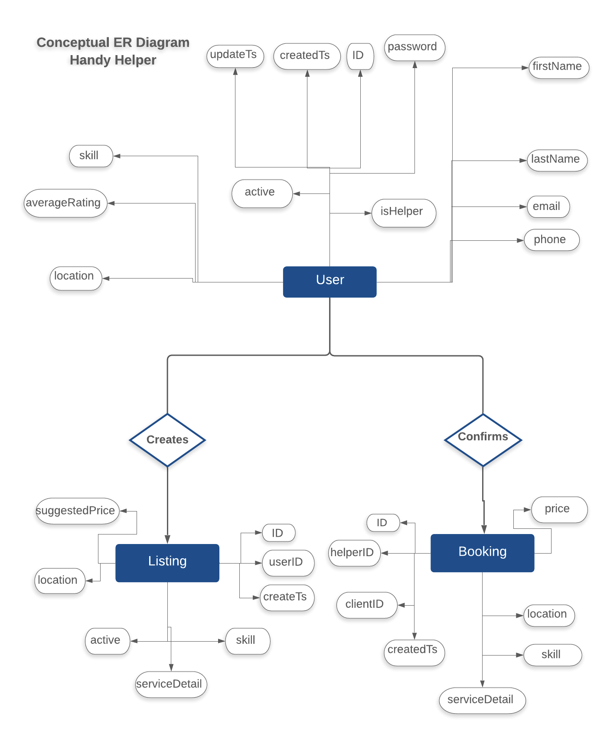
image
availability
emailPreferences

Slide 2
